Slide 1
Developing ‘Connect With Me’ through the SEND Hub for Early Years in Newham
CWM – SEND Hub
A pilot study for effective cross – sector working by developing an integrated early intervention model for under-fives, on an autistic spectrum pathway, and their parents.

Slide 2
Inspiration!
CWM – SEND Hub
The exemplary work of the Champion Centre in New Zealand demonstrates that those children with SEND whose families have been engaged in a frequent, long-term, relationship-based, strength-based integrated ECI programme, “make important developmental gains year on year and most children graduate into mainstream school” (Champion Centre, 2016).
The ethos of their approach is that the programme delivery is relational, family centered, strengths-based, ecological and reflective. Its success relies on “the integrated and co-ordinated multi-disciplinary team working, dedicated and professional staff, cultural competency, organisational infrastructure and the programme of transition to school”.

Slide 3
Early Intervention Model
CWM – SEND Hub
In March 2017 staff from the SEND Hub in Newham visited Longcause , a community special school for children with autism in Plymouth which is currently running the only UK replication of the Champion Centre approach
We spent an inspiring day experiencing the ‘carousel’ system first hand and meeting the parents and children being supported so successfully through this 8 week project.
Parents attend with their child one morning a week and rotate around the 6 groups of the carousel:
Early Communication run by a teacher
Attention Autism run by a teaching assistant
Musical Play run by a music therapist
Occupational Therapy run by an independent OT
Playwork run by a teaching assistant
Family Support run by the FSW

Slide 4
Parents at the Heart
CWM – SEND Hub
Moving parents into this position is powerful on many levels:
It truly acknowledges the role of the parent as the first educator rather than just paying lip service to a well-worn phrase;
parents are acknowledged as experts on their own child and can share their well-informed opinions with professionals which can save time;
working together parents and professionals can piece together a more holistic picture, understanding the child in the context of their home life as well as their school life;
therapy practices become ingrained in daily life thus maximising the impact of expensive therapy time;
parents become advocates for their child as they make sense of the world and this could reduce the likely involvement of social care as children get older and life becomes harder to navigate sensibly.

Slide 5
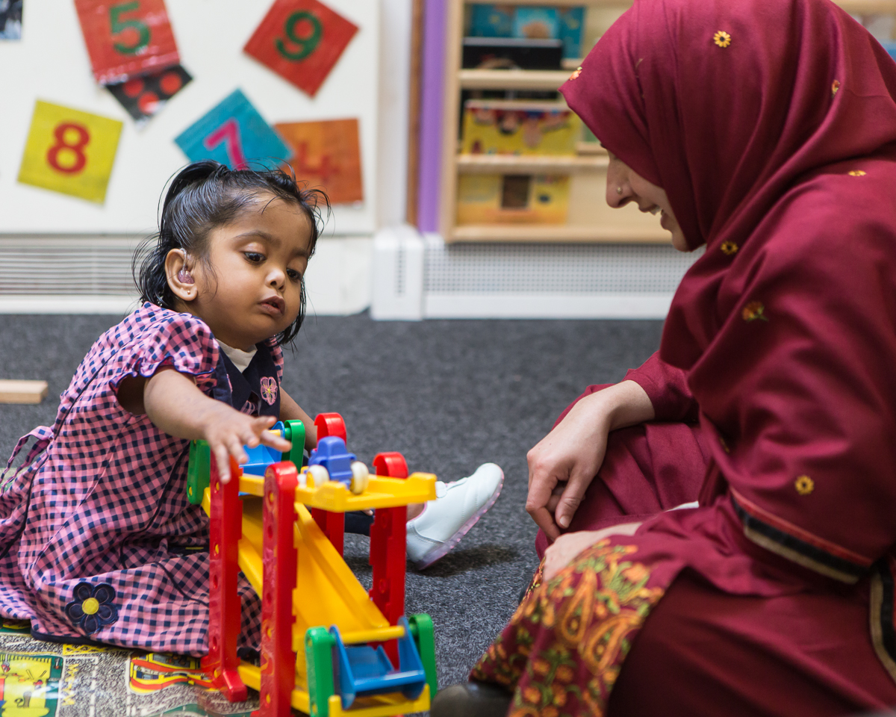

Slide 6
Why is such a model needed in Newham?
Increasing numbers of under fives awaiting diagnosis for ASC
Long waiting lists suggest services are struggling to meet demand
The current model does not promote a partnership between the family and professionals
There is no team around the child and too many uncoordinated appointments are generated
Waiting lists and gaps between appointments are too long
Working families find it difficult to balance attendance with work commitments and risk case closure through non-attendance
There is no link to inclusion into education, leisure and play activities which increases family isolation and impacts on well-being

Slide 7
So what are we doing in Newham?
The SEND Hub are piloting a multi therapy intervention project ‘Connect with Me’ involving a small target group of 2 years olds on an ASC pathway to evaluate the benefits of:
Supporting parents from an earlier point than is currently practicable (and the initial feeling is that this is where we will see the greatest impact)
Smarter working for therapists seeing several children in one half day and whilst measuring impact according to their own discipline a key element is working together.
Establishing a clear, holistic picture by sharing observations and maintaining one set of notes per child to plan appropriate pathways for children into education.
However, each profession has a different IT system, these systems do not ‘talk’ to each other, there are different ‘information-sharing protocols’ and parents cannot make independent access to these notes.

Slide 8
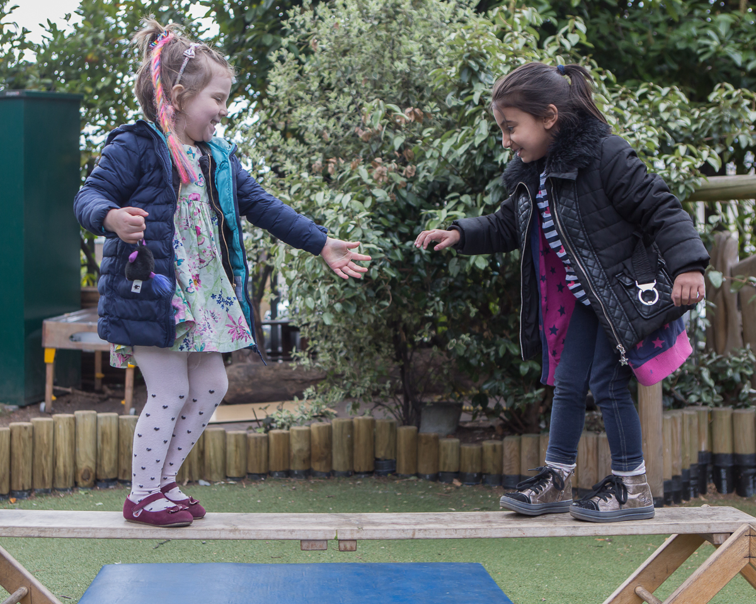

Slide 9
Smart IT to support smart working
Connect With Me provides the opportunity for therapists to work intensively with 6 families (per day).
(If we had 2 teams this could be doubled and if this became the way of delivering services to children on an ASC pathway 60 families per week could be supported so that would be a smart move!)
We have been challenged by lack of access to each others IT systems
How can we collate this information in one secure place so that parents and professionals can read and contribute whilst keeping within the legal requirements?
We think this is ground breaking work which deserves to be supported by first class technology……..can you help?
Contact alison.lentz@ronaldopenshaw.newham.sch.uk

Slide 10
