Slide 1
How can AAL and e-health solutions be perceived by users as added value?
Symposium at RBS Jan 23/24, 2018, London Brigitte Bührlen
Notes:
Oben professionelle Pflege
Unten Laienpflege

Slide 2
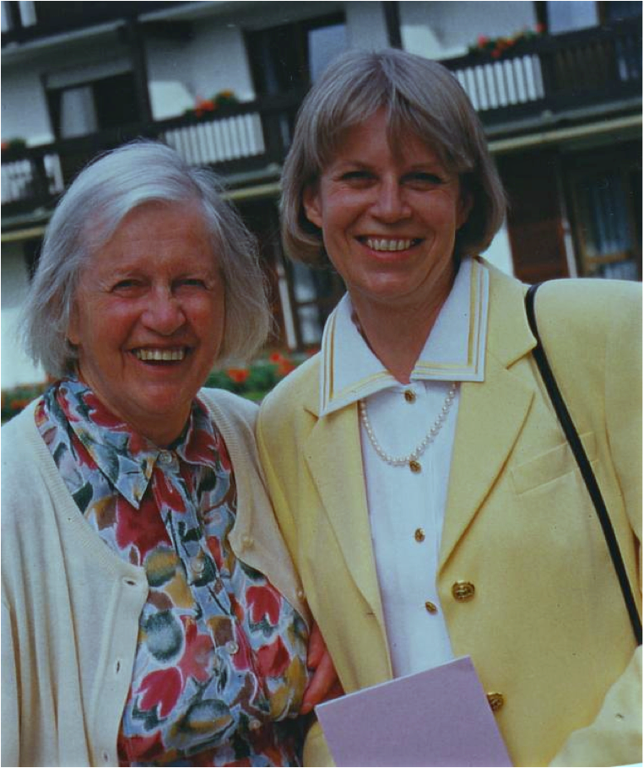
Past - Present - Change
Family caregivers take over responsibility for organizing relatives life on 24 hours a day, 365 days a year.
Relationships have changed, people often no longer live in stable, sustainable relationships.
Demographic change is one of the greatest challenges in all industrialized countries.
The concept of family must be redefined.
Only together and with the help of intelligent technology we will be able to handle them.
How can AAL and e-health solutions be perceived by users as added value?
Symposium at RBS Jan 23/24, 2018, London Brigitte Bührlen
Notes:
Oben professionelle Pflege
Unten Laienpflege

Slide 3
Future
It is therefore our task to decide together what our common future should be and what it will look like.
Women are nowadays well educated, they want to work and they often have to work. How can they work, look after children and care at the same time for relatives in need of help?
The topic is complex and multifaceted. More and more often women have their children later. It is therefore not only about caring for the elderly, but also about the simultaneous compatibility of child and parent care.
We must take care for our future, it`s five minutes to twelve.
Symposium at RBS Jan 23/24, 2018, London Brigitte Bührlen
Notes:
Oben professionelle Pflege
Unten Laienpflege

Slide 4
Digital support
If you want to live in your own house or apartment, digital support can enable you to manage everyday activities:
Networking with professional and volunteer services, authorities and insurance companies, neighbours, friends and family members.
An e-Health and AAL support ring can be built around a person in need: Communication systems connect technical assistance services and support the exchange of information with doctors, caregivers, relatives and friends, hospitals, insurance companies and authorities as well as with the community services.
We need intelligent technologies and digital solutions that connect people in need of support with supporting structures and services.
How can AAL and e-health solutions be perceived by users as added value?
Symposium at RBS Jan 23/24, 2018, London Brigitte Bührlen
Notes:
Oben professionelle Pflege
Unten Laienpflege

Slide 5
Digital support
Those, who live in senior apartments or nursery homes can be cared for through e-Health and AAL offers individually :
Voice guidance and control e.g. according to the principle of “Alexa”
Preventive digital gymnastics e.g. movement games
Online connection with relatives, nursing staff or doctors by mobile, tablet or PC on Skype, face time or similar
Vital signs control, fall detection, GPS localization etc.
How can AAL and e-health solutions be perceived by users as added value?
Symposium at RBS Jan 23/24, 2018, London Brigitte Bührlen
Notes:
Oben professionelle Pflege
Unten Laienpflege

Slide 6
In General
Offers must be demand-oriented, not age is decisive!
From a large "Universal Design“ product range everyone receives individually and self-determined what they need.
AAL offers must be available everywhere and for everyone.
Self - learning systems should be further developed.
Personnel services can increasingly be provided by automated systems.
Digital literacy should be systematically promoted.
Representatives of politics, business, science, local authorities, administrations, users and citizens should meet at communal roundtables (hackatons) across all interfaces and jointly develop sustainable socio-spatial digital support services.
AAL offers should be linked to "Smart City"concepts.
How can AAL and e-health solutions be perceived by users as added value?
Symposium at RBS Jan 23/24, 2018, London Brigitte Bührlen
Notes:
Oben professionelle Pflege
Unten Laienpflege

Slide 7
Problems
Where are there problems with technical digital solutions?
Artificial animals or humanoid robots often cannot replace human attention and empathy.
There may be ethical problems with the use of data. There is a risk of uncontrollable transfer or further use of data without the consent of the person in need of support.
Who owns the data collected? Who can reuse them?
Digital networking without digital legislation and regulation is problematic.
How can AAL and e-health solutions be perceived by users as added value?
Symposium at RBS Jan 23/24, 2018, London Brigitte Bührlen
Notes:
Oben professionelle Pflege
Unten Laienpflege

Slide 8
Conclusion
We should be aware that a new generation of "old people" and also a new generation of family carers, of sons and daughters and citizens will follow.
Digital support is gladly accepted and used if it really relieves the everyday life and arouses positive emotions.
AAL offers should bring joy and quality of life. They should not only be "useful”!
We will only buy offers we accept! So take us on board!
How can AAL and e-health solutions be perceived by users as added value?
Symposium at RBS Jan 23/24, 2018, London Brigitte Bührlen
Notes:
Oben professionelle Pflege
Unten Laienpflege

Slide 9
Thank you for your attention!
It's up to us where the journey takes us !
Symposium at RBS Jan 23/24, 2018, London Brigitte Bührlen
Notes:
Oben professionelle Pflege
Unten Laienpflege

